Slide 1
Docker Network Objeleri - 1
Container 102

Slide 2
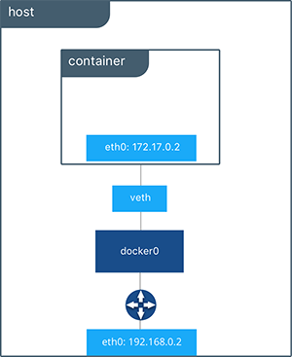
Bridge Network’e bağlı container

